Slide 1
Direct Funding Reimbursement Request Process
SY 2022-2023
www.nmschoolscovidtesting.com
Questions? reports@nmschoolscovidtesting.com

Slide 2
Need help?
Guidance Page
Password Assistance Form
Office Hours
info@nmschoolscovidtesting.com
Phone Line: 505-418-5050

Slide 3
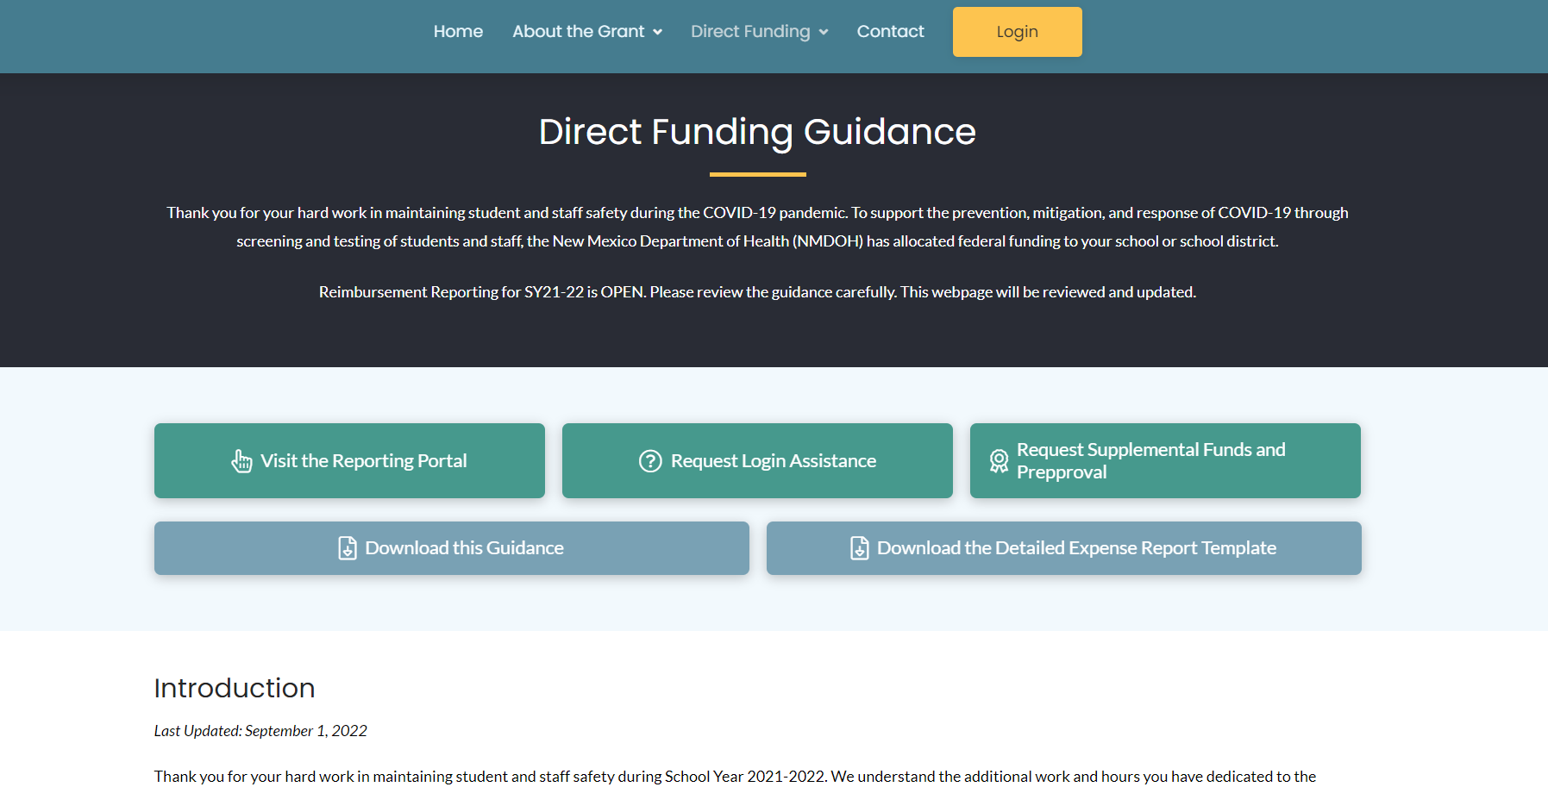

Slide 4
About Direct Funding
$63 million (85% for school COVID -19 testing and screening)
All K-12 schools and districts are eligible.
COVID-19 prevention, mitigation, and response for SY 2021-2022.
Kesselman-Jones serves as fiscal agent, distributing funds via check in the mail.
CK 19-1904 COVID-19 Supplemental Funds ELC Reopening Schools.
This grant is a part of the $1.9T American Rescue Plan of 2021.

Slide 5
Opportunities
Use your leftover allocation from SY 21-22
Request additional funding
Seek preapproval
Submit an appeal

Slide 6
Important Dates
January 1, 2023: Schools and districts must report use of 75% of allocation or submit preapproval for a spending plan
May 12, 2023: Last day to report expenses related to SY 22-23
June 30, 2023: Final check sent

Slide 7
Allowable Expenses
Example Guide (we will update):
https://nmschoolscovidtesting.com/direct-funding-info/#allowable-expenses
Test kits and testing vendors now included!
COVID-19 Prevention, Mitigation, and Response
Staffing
Supplies
Services
Capital Improvements
Other

Slide 8
Reporting and Requesting Reimbursements

Slide 9
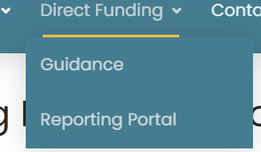
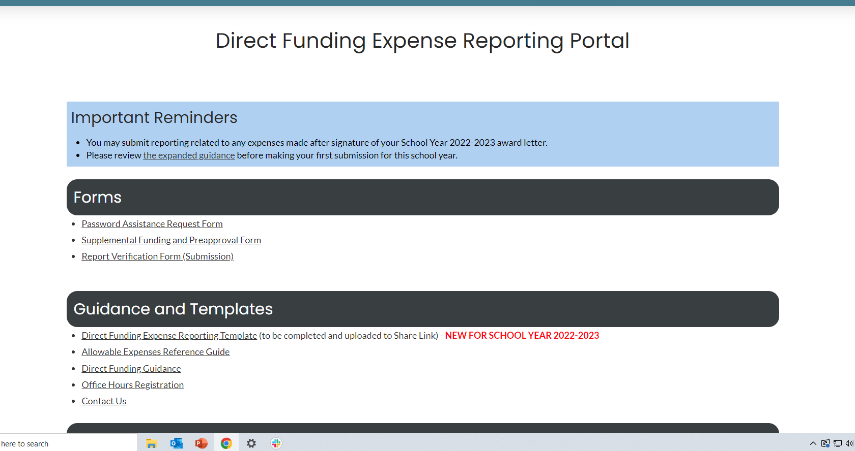
Reporting Portal
https://nmschoolscovidtesting.com/reporting-portal/ - You must be logged in and opted into Direct Funding to see this page!
Notes:
After registering for the program and returning your award letter, you will receive your school or district’s login information via email. Visit www.nmschoolscovidtesting.com and click the “login” button on the top right corner to enter into the site.

Slide 10
Through the Reimbursement Request Platform:
Provide documentation and request details
Public charters and districts may prepare a report using their own accounting systems and upload into the share link. Fund code is 28211. We still recommend using our template.
Nonpublics, BIE, and tribally-controlled schools will use the Detailed Expense Template and upload documentation into the share link
Finalize your request
All entities requesting funds must submit a final verification for their request to be processed
Notes:
There are two ways to prepare a reimbursement. Public districts and charters may use their own accounting system to prepare their requests for reimbursements, just like they would for an RfR request in OBMS. They will still be required to upload their summary reports and backups to the share link provided. All other schools must use the templates provided to indicate their line items. They will upload documentation into the share link as well.
All schools and districts requesting funds must finalize their request by submitting the final verification, located at the bottom of the Reimbursement Request Platform page.

Slide 11
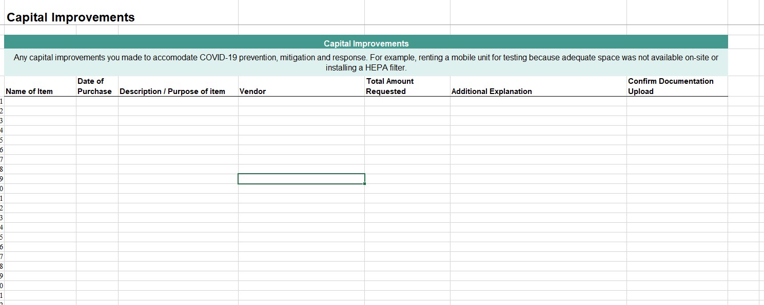
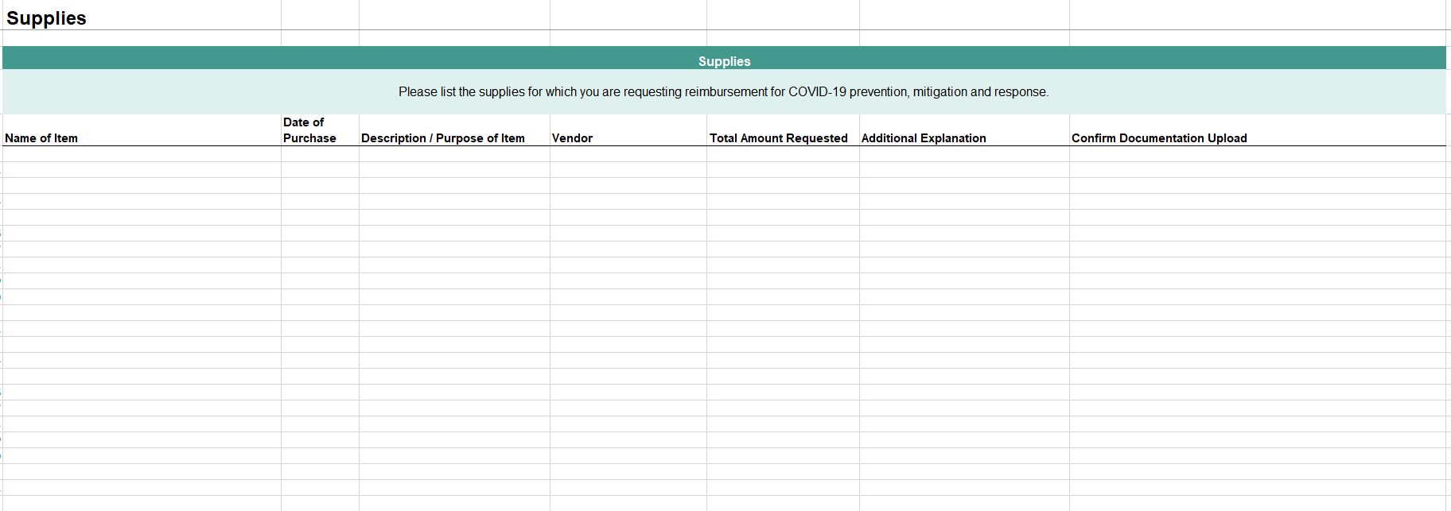
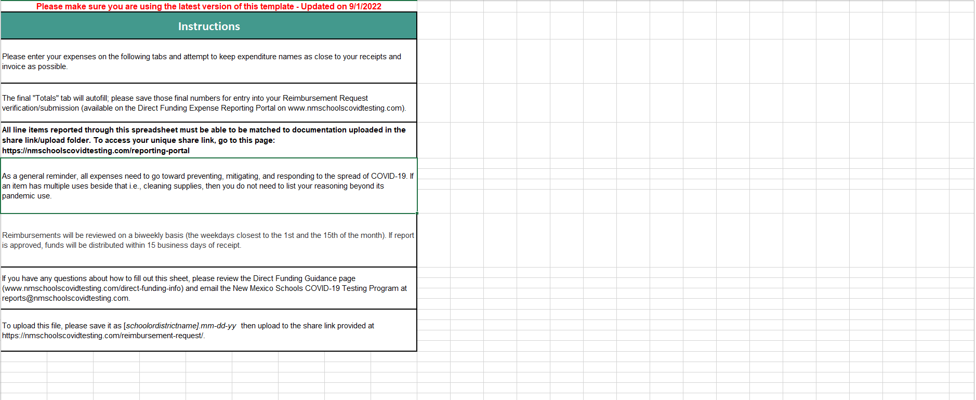
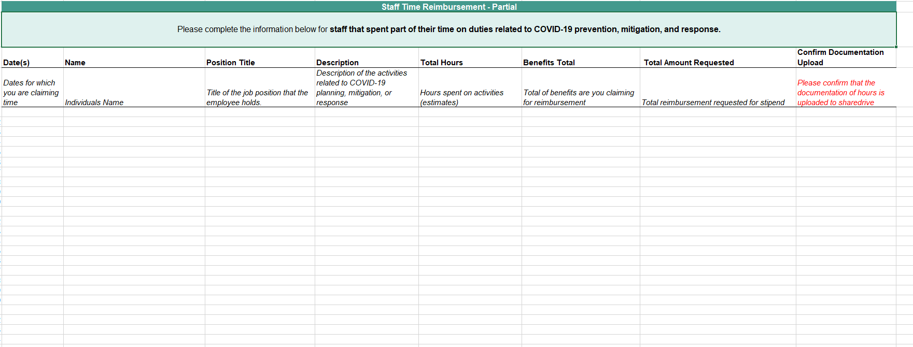
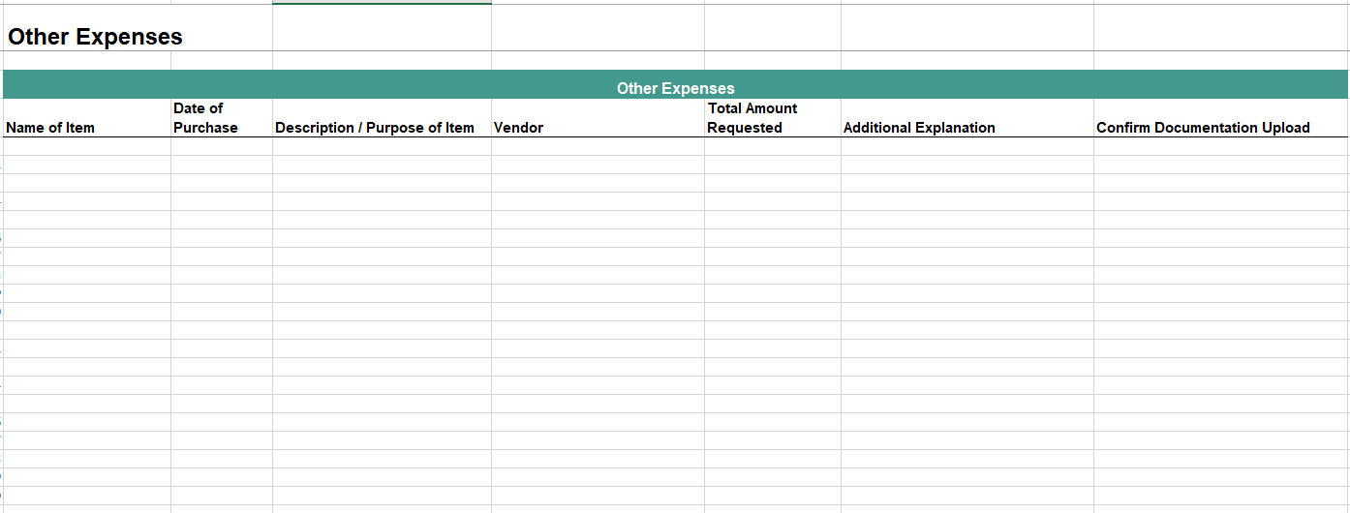
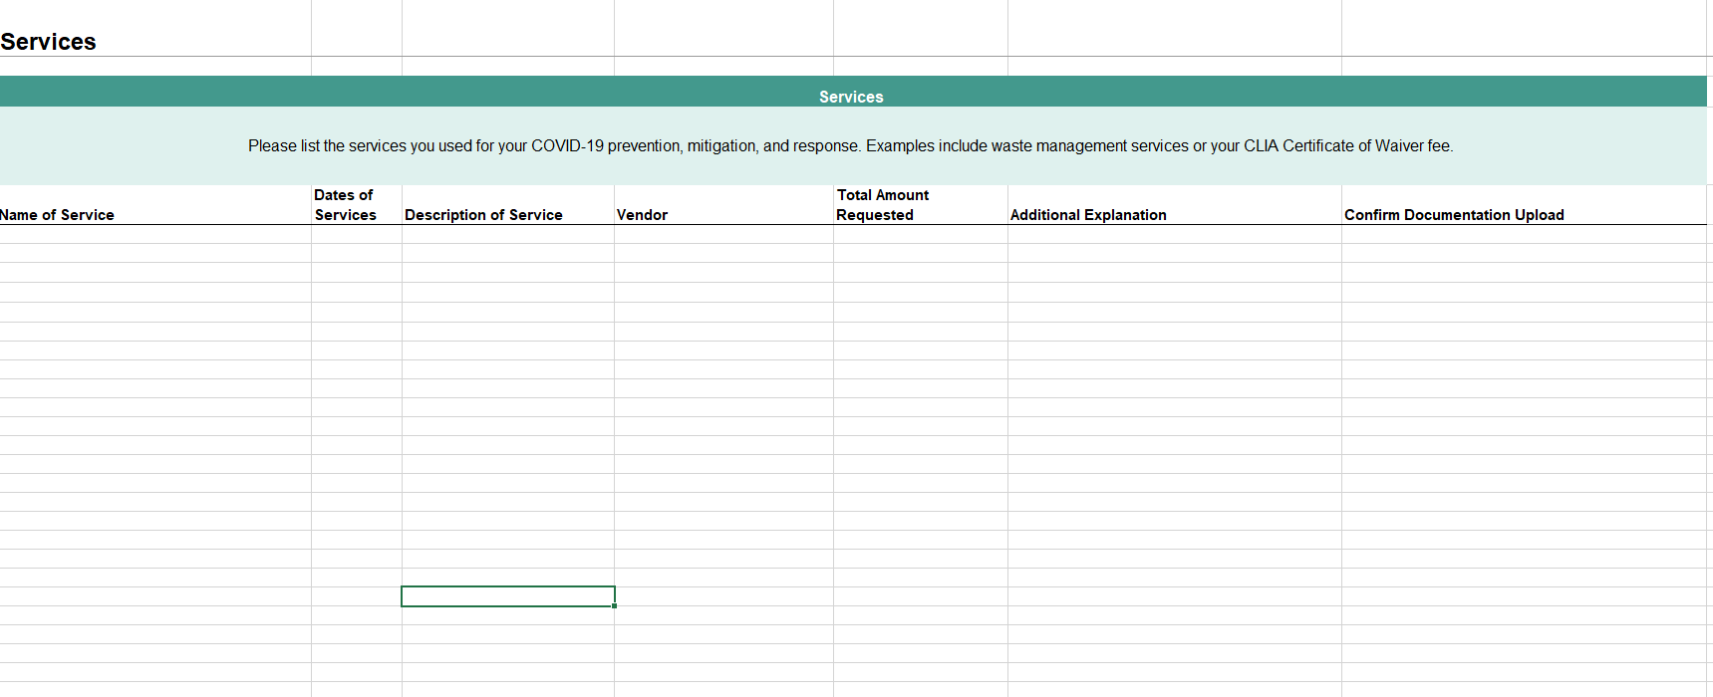
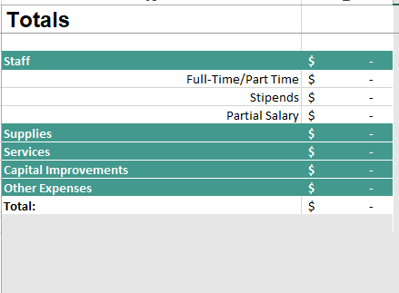
Detailed Expense Reporting Template
It’s teal!
Notes:
There are two ways to prepare a reimbursement. Public districts and charters may use their own accounting system to prepare their requests for reimbursements, just like they would for an RfR request in OBMS. They will still be required to upload their summary reports and backups to the share link provided. All other schools must use the templates provided to indicate their line items. They will upload documentation into the share link as well.
All schools and districts requesting funds must finalize their request by submitting the final verification, located at the bottom of the Reimbursement Request Platform page.

Slide 12
Documentation
Staffing
Full-Time: Nothing extra (but please indicate responsibilities in expense report)
Portion of Salary: Timesheets/Affidavit/Estimates
Stipend: Contract
Services
Contract/Receipt
All other
Receipts

Slide 13
Your Share Drive (Find link on portal)
Upload Detailed Expense Reporting Template (or Summary Report if your school/district is public) & Documentation

Slide 14
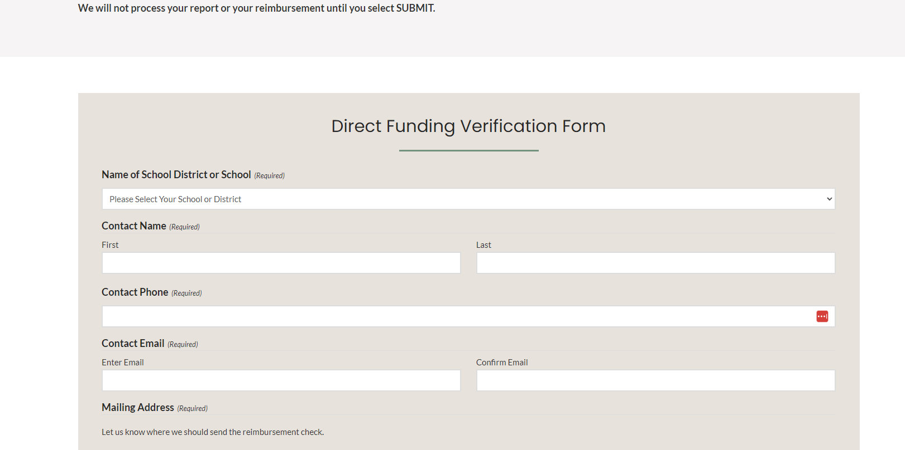
Verify

Slide 15
How We Review
Review submission:
All expenses listed in the report are allowable – If we are unsure, we will bring the expense to the NMDOH/NMPED review committee and/or the CDC for further discussion.
The totals listed in the Detailed Expense Reporting Template (or, if you are a public school district/charter, your Summary Report) match the totals on receipts.
Each expense listed has the appropriate backup.
Each expense has not been previously submitted.
Each expense is related to SY 22-23.
Approve report
Send checks (1st and 15th of the month)
Notes:
Once we receive your reimbursement submission, our team will do a quick check to make sure we have what we need. If we are missing any documentation, we will reach out to you and ask you to resubmit your reimbursement request. Following that check, we will do a more in-depth review to ensure that your expenses are allowable costs under the terms of the grant. Your request will be processed within 15 business days, unless there are issues with your report. While previous guidance and award letters stated that reimbursement requests would be processed at specific points of the year, we have updated our processes so that we are sending funds on a biweekly basis. One approved, we will send checks via UPS to the address provided.

Slide 16
Recommendations and Reminders
You will be responsible for submitting documentation for all of your expenses.
Please do not submit a new reimbursement while an existing reimbursement is being processed.
We recommend submitting requests often, rather than waiting until the end of the year or the quarter.
Notes:
We would like to close this video with a few reminders. First, all expenses made through these funds, including those made through the advance, must be reported on. If you would prefer to catch up on your expenses before receiving additional funds, please indicate so when you finalize your reimbursement request.
Please do not submit a new reimbursement request while an existing reimbursement is being processed. We will only be reviewing one request from a school or district at a time.
Lastly, our general guidance is to submit requests often, rather than all at once. The final reporting day is June 25, 2022, and all funds must be expended by June 30, 2022.

Slide 17
Received an advance?
DO NOT FORGET TO REPORT!

Slide 18
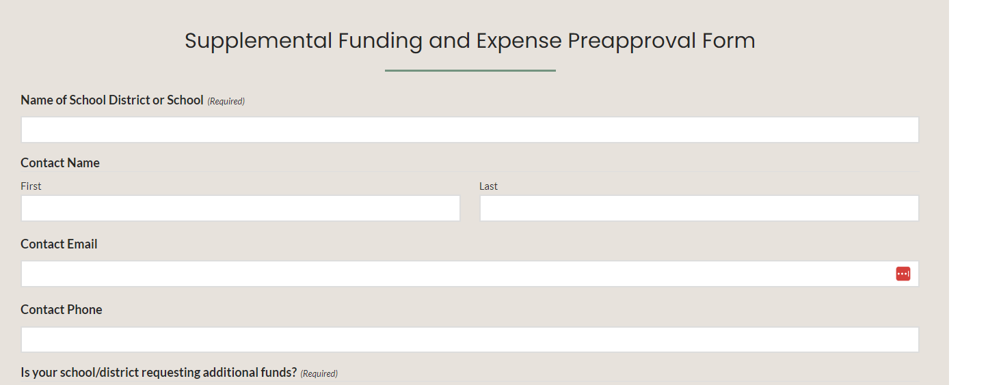
Supplemental Funds & Preapproval
https://nmschoolscovidtesting.com/form-supplemental-preapproval/
Notes:
After registering for the program and returning your award letter, you will receive your school or district’s login information via email. Visit www.nmschoolscovidtesting.com and click the “login” button on the top right corner to enter into the site.

Slide 19
Need help?
Guidance Page
Password Assistance Form
Office Hours
info@nmschoolscovidtesting.com
Phone Line: 505-418-5050

